Slide 1
Predicting Car Mileage, 1970-1982
Using a data set of Car Mileage from 1970 to 1982, my objective was to illustrate the linear regression methods being taught in Math 327
The research questions I would like to answer from these data are
What set of car features best predict car mileage?
How precise are those predictions?

Slide 2
Response and Predictor Variables
Response variable
MPG – Miles per Gallon
Predictor variables in the data set were
Number of cylinders – 3, 4, 5, 6, or 8
Displacement – a measure of engine size
Horsepower – a measure of engine capacity
Weight – total car weight in pounds
Acceleration – how fast can the car accelerate
Year of manufacture
Country of Origin (Europe, Japan, U.S.)
There are 392 cars in the data set

Slide 3
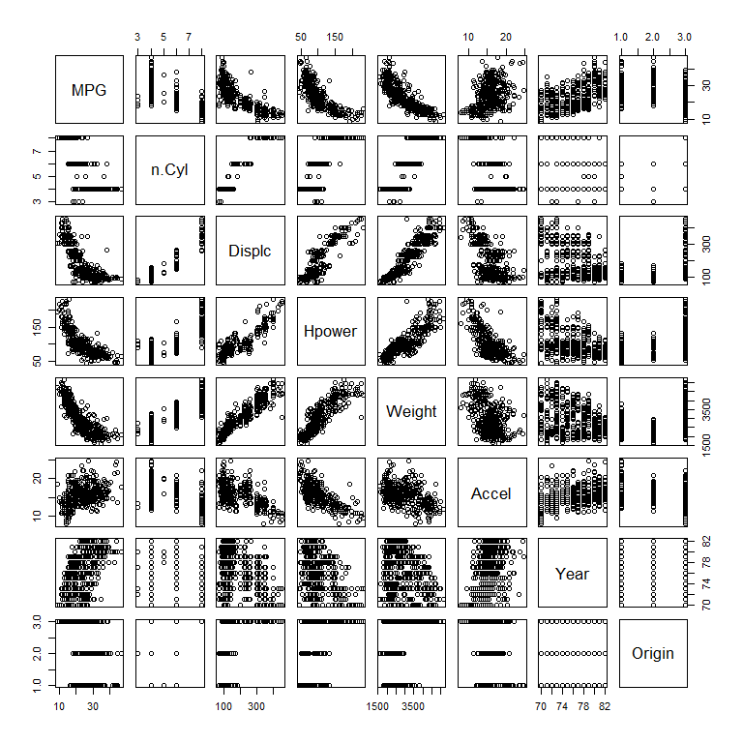
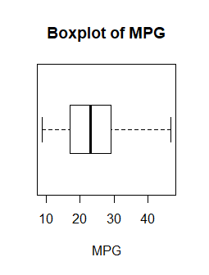
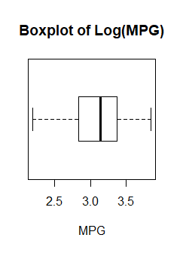
Distributions and Correlations
The distribution of MPG is somewhat right-skewed, while the distribution of Log MPG is more symmetric to slightly left skewed. None of the predictor variables needed to be transformed (not shown).
There is a curvi-linear relationship between MPG and several predictor variables – Displacement, Horsepower, and Weight. There is also high correlation among those same predictors.

Slide 4
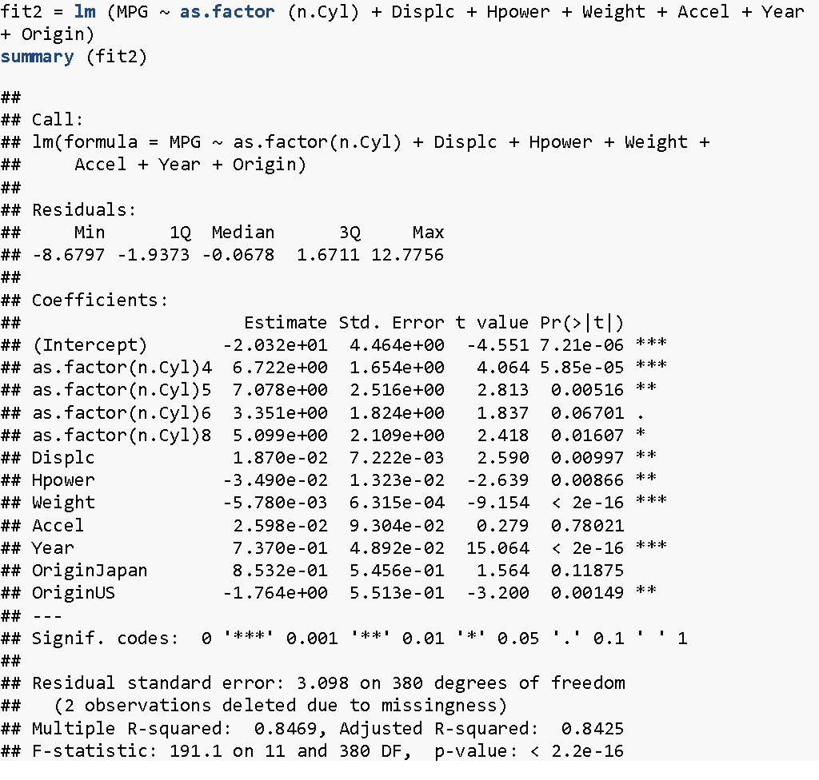
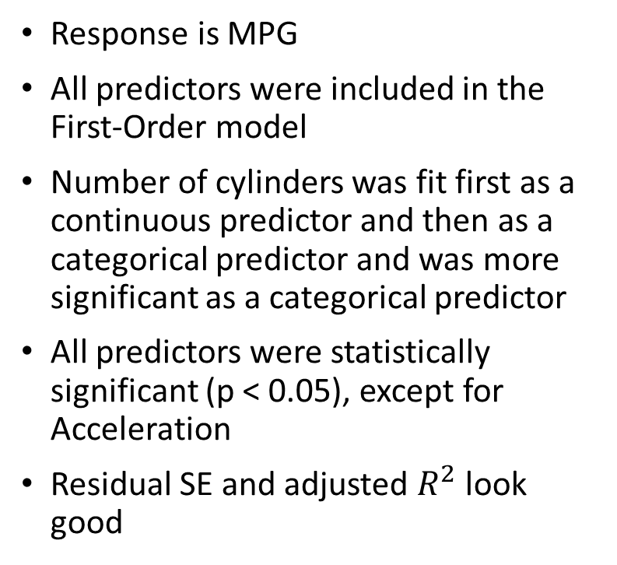
First-Order Model

Slide 5
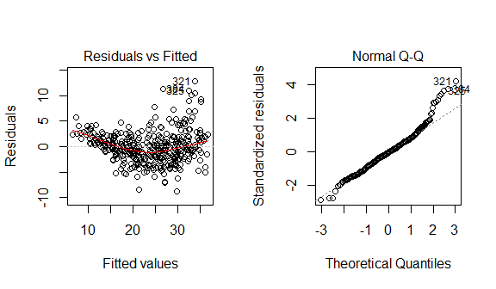
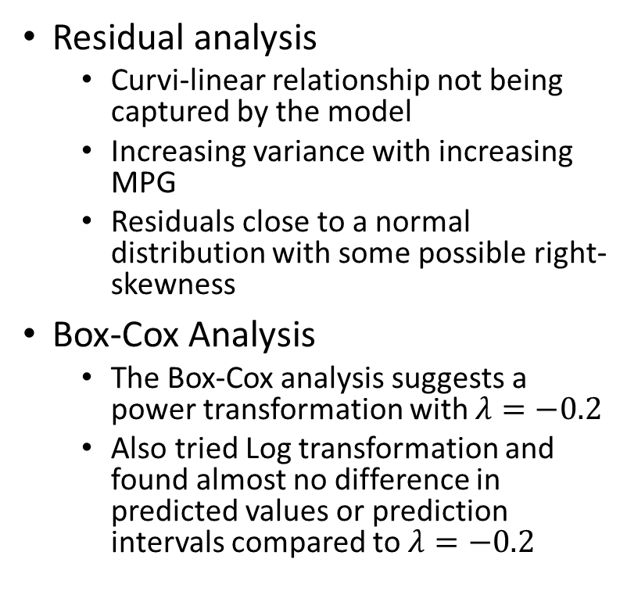
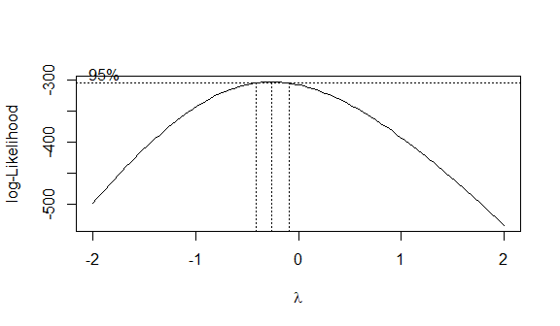
First-Order Model
Box-Cox Plot

Slide 6
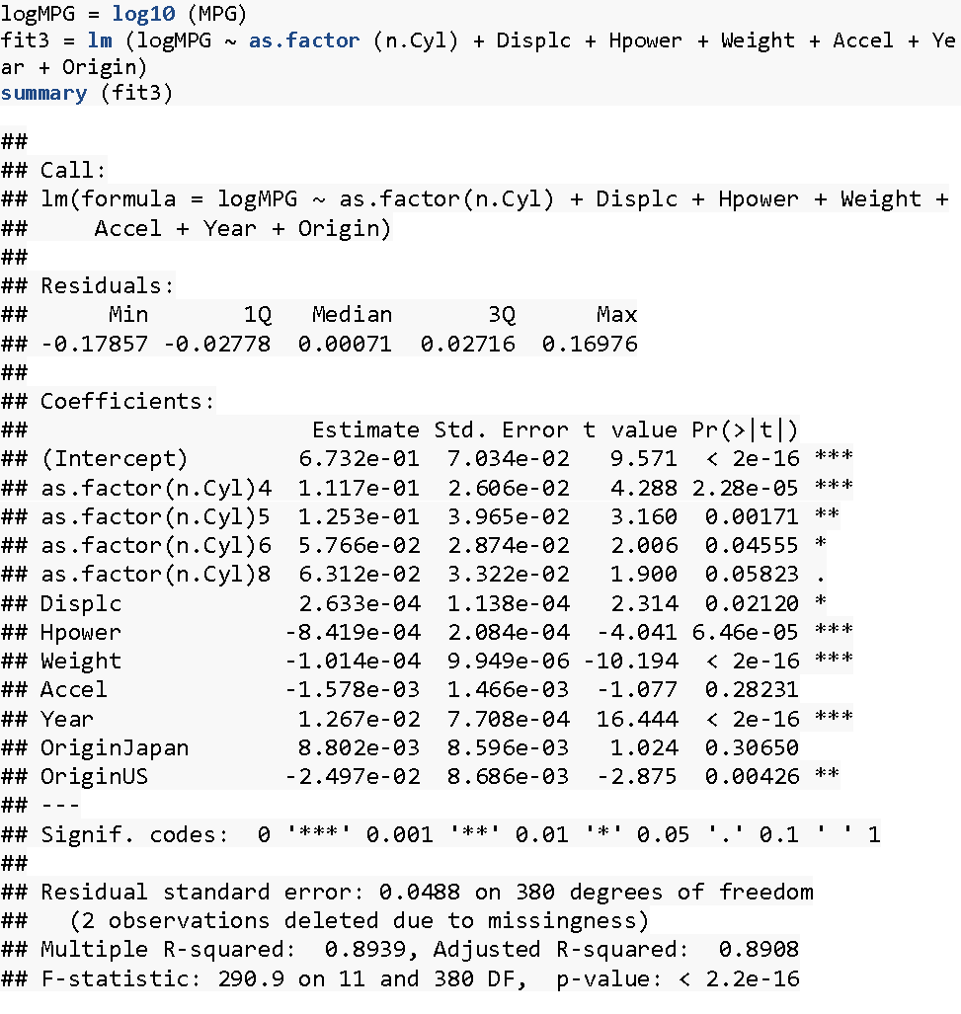
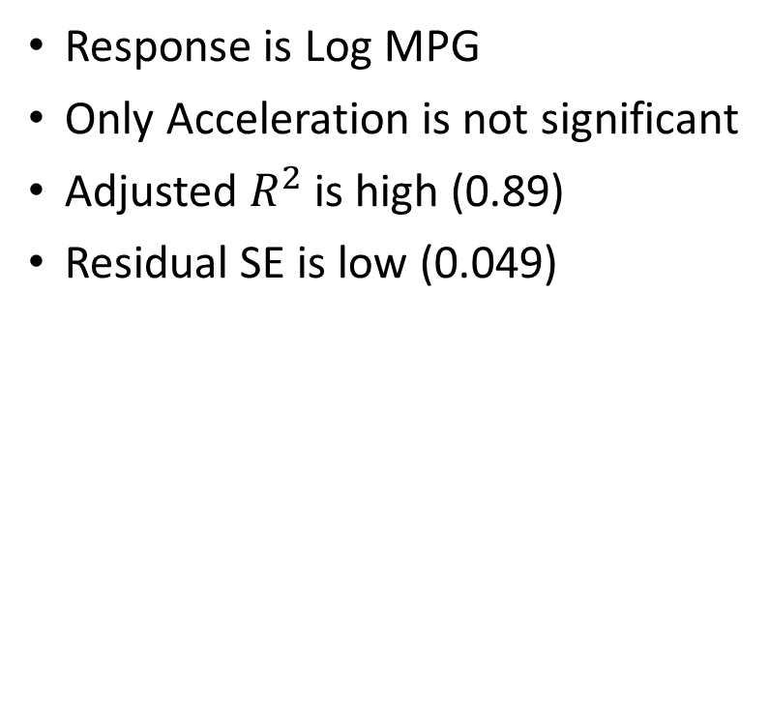
First-Order Model Log MPG

Slide 7
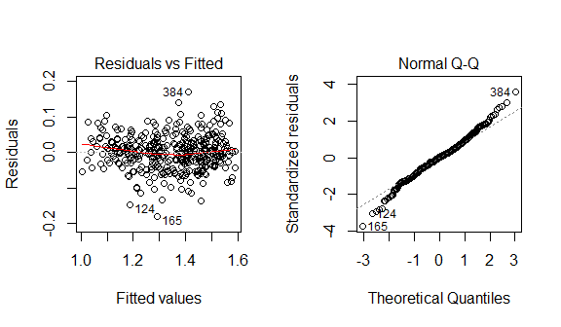
First-Order Model Log MPG
Residual analysis
The residuals look much better with Log MPG as the response variable
No obvious patterns
The residual variance is constant
The residual distribution is close to normal, with slightly heavy tails

Slide 8
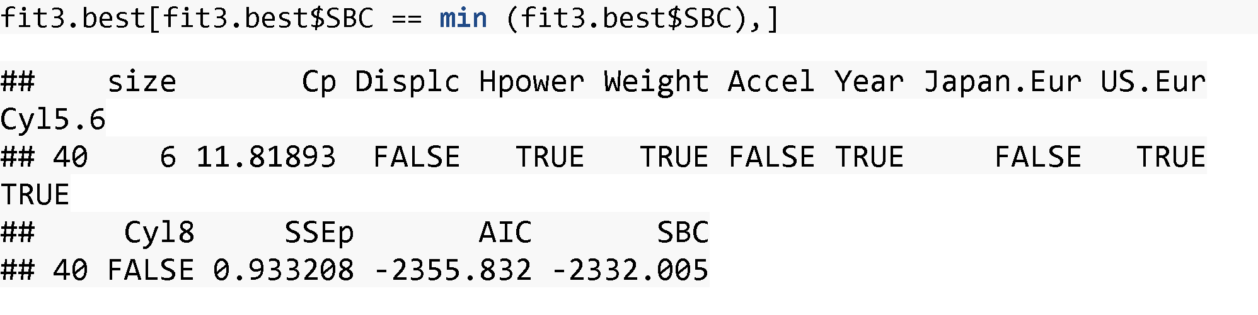
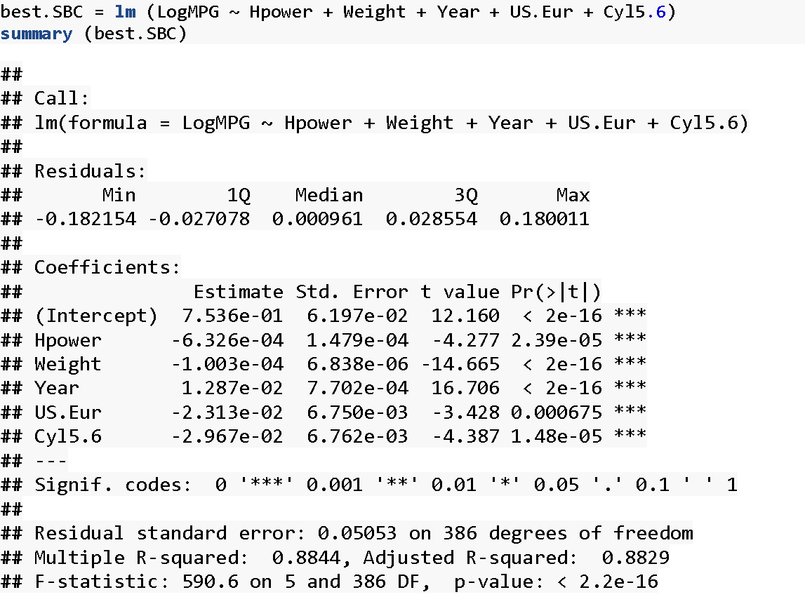
First-Order Model – Best Subsets Analysis
Using the leaps function with the SBC criterion, the best subset of first-order predictors was
Horsepower
Weight
Year
U.S vs Europe indicator
5-6 cylinders vs 3-4 cylinders indicator

Slide 9
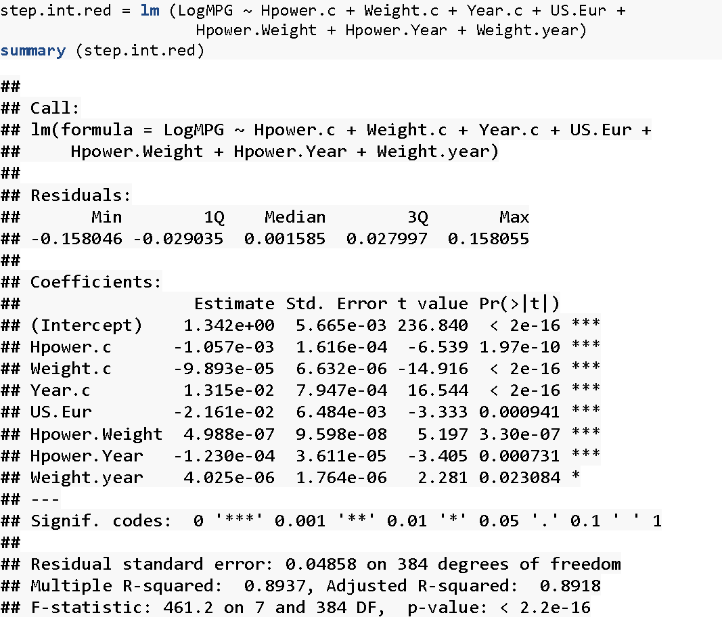
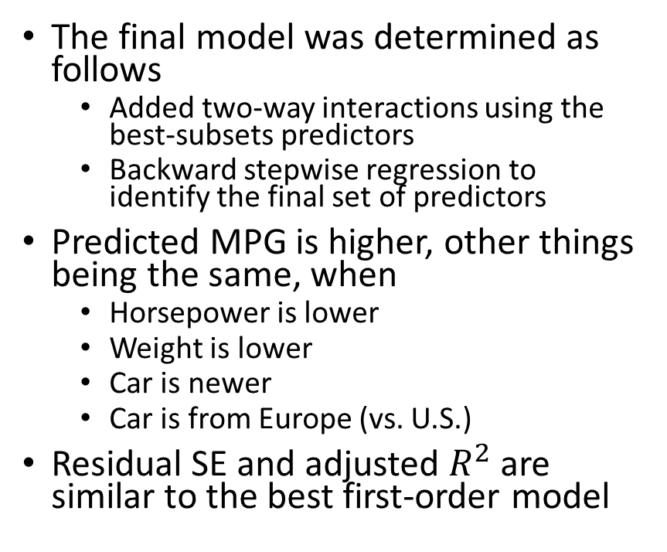
Final Model

Slide 10
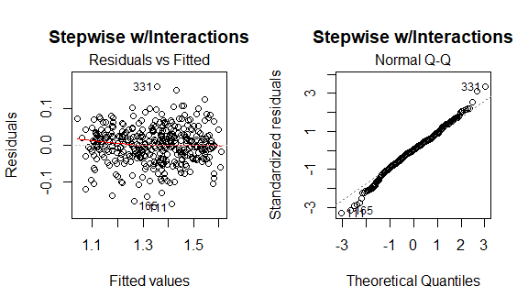
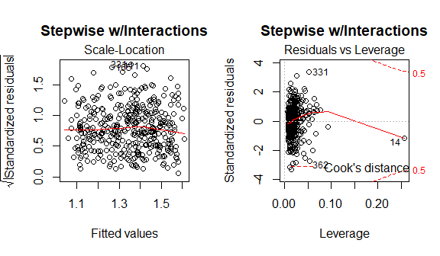
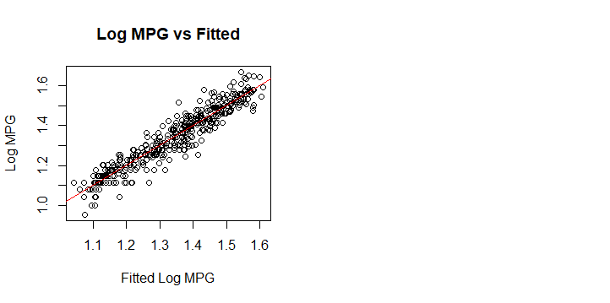
Final Model
Residual and Influence analysis
No obvious patterns
Constant variance
Distribution close to normal
Row 14 had high leverage, but removal did not impact the results

Slide 11
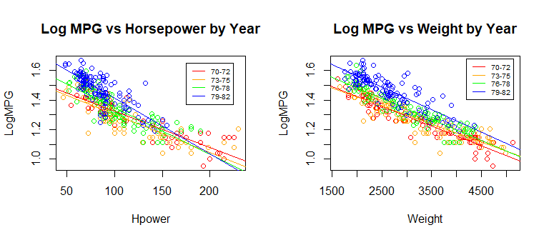
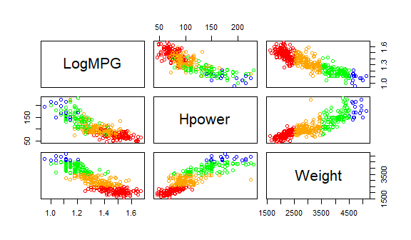
Final Model – Interaction Effects
Log MPG vs Horsepower by Weight
The Log MPG vs Horsepower slope is steeper for newer cars, and not as steep for older cars (p = 0.0007)
The Log MPG vs Weight slope is slightly steeper for newer cars, and not as steep for older cars. This interaction effect is less significant (p = 0.02).
The Log MPG vs Horsepower slope is steeper for lighter weight cars, and not as steep for heavier cars (p < 0.0001).

Slide 12
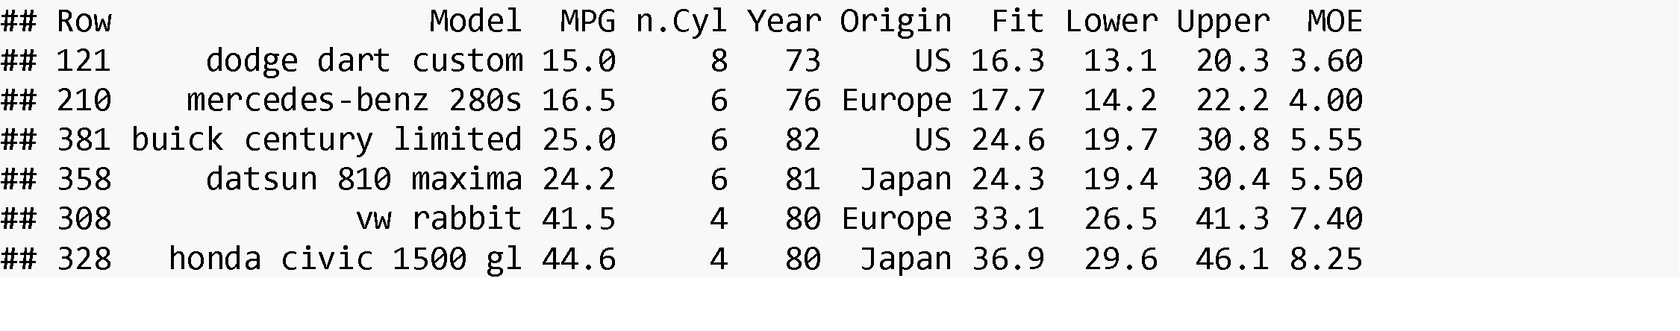
Final Model – Example Predictions
When MPG is lower, the model can predict MPG with a precision of about +/- 4 MPG (95% prediction limits). For MPG in the mid-20's, the precision is about +/- 5.5 MPG, and for high mileage cars (MPG > 40), the precision is around +/- 8 MPG. The prediction intervals become wider with higher MPG, because I modeled Log MPG.
Note that the prediction interval for the VW Rabbit (26.5 - 41.3) does not quite contain the actual MPG value (41.5). We expect this to happen 5% of the time, since we're using 95% confidence for these intervals.
MOE = Margin of Error = half of the prediction interval width.

